Slide 1

Familiarization with DC and AC sources
Supervised By-
Dr. Pydi Ganga and Dr. Sujit
EECS Department
IISER Bhopal, India
Prepared by:-
Md Asif Khan
Dayarnab Baidya
Ariba Siddiqui

Slide 2
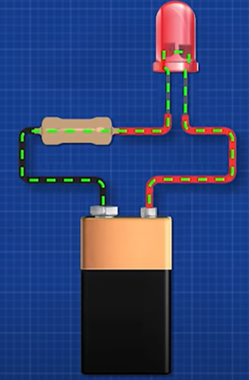
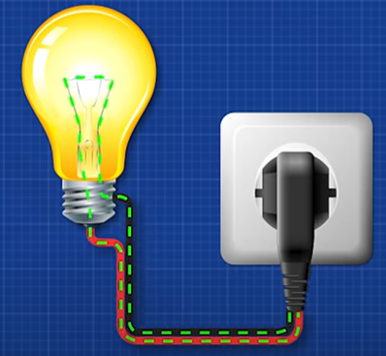
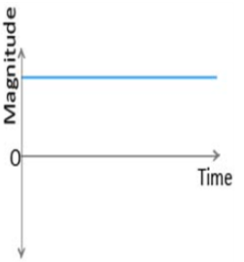
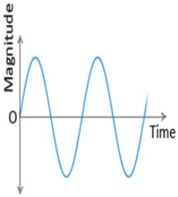
Difference between DC and AC
Direct Current (DC) | Alternating Current (AC)
Electric charge or current flow only in one direction | Electric charge or current flow changes its direction
Magnitude is constant | Magnitude is varying
Source of avalability is cell or battery | Source of avalability is generator or mains
DC circuit have only resistance | AC circuit have resistance, inductance and capacitance
Frequency of DC is zero | It can be diffirent value but 50Hz used in mains of India
Wave is pure constant form | Wave are sinusoidal, traingular, square form
Used in electronics device such as mobile, laptop, and TV | Used in distribution, generation and mains line
I_{max}
I_{max}

Slide 3
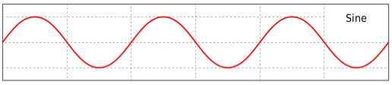
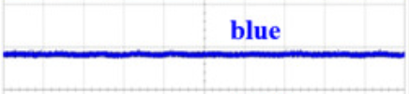
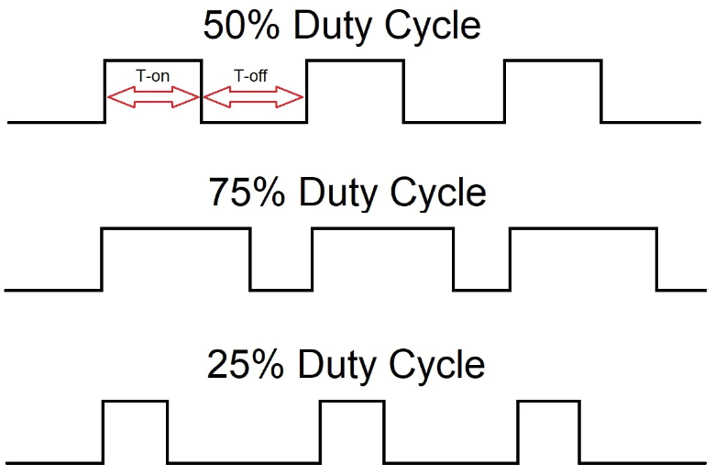
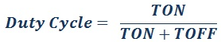
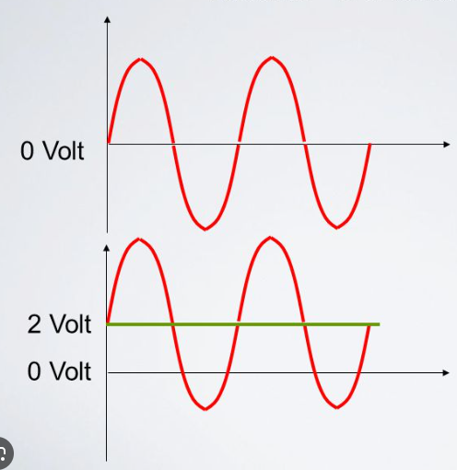
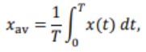
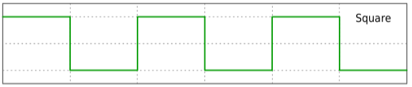
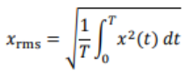
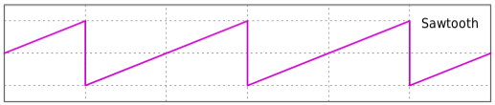
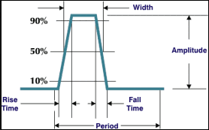
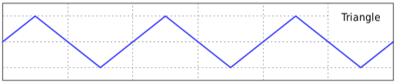
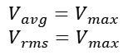
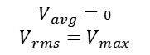
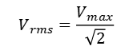
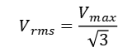

Parameter of Different Waveform
Duty cycle
V_{max}
DC
$$V_{avg}=V_{max}$$
$$V_{rms}=V_{max}$$
0V
V_{max}
$$V_{avg}=0$$
V_{max}
Offset
0V
$$V_{rms}=\frac{V_{max}}{\sqrt{2}}$$
V_{min}
V_{min}
Sint
V_{max}
$$V_{avg}=0$$
$$V_{rms}=V_{max}$$
T
2T
0V
2 + Sint
V_{min}
T
2T
V_{max}
$$V_{avg}=0$$
Rise and Fall time
0V
$$V_{rms}=\frac{V_{max}}{\sqrt{3}}$$
V_{min}
Rise time is typically measured from 10% to 90% of the value
V_{max}
$$V_{avg}=0$$
0V
$$V_{rms}=\frac{V_{max}}{\sqrt{3}}$$
V_{min}

Slide 4
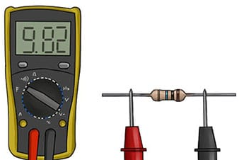
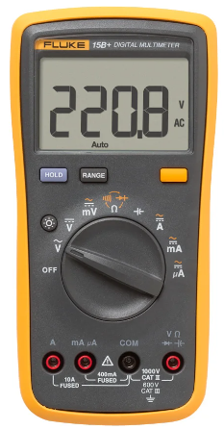
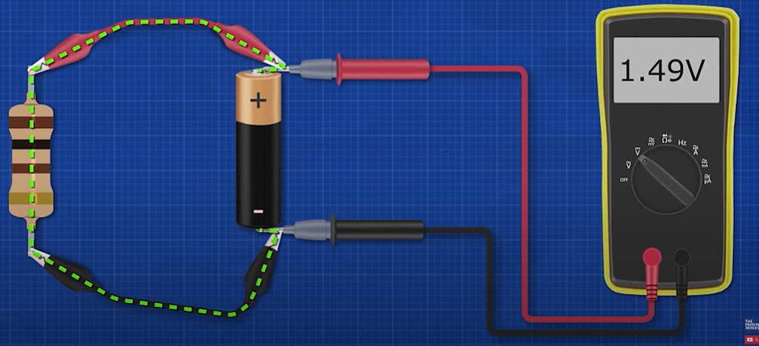
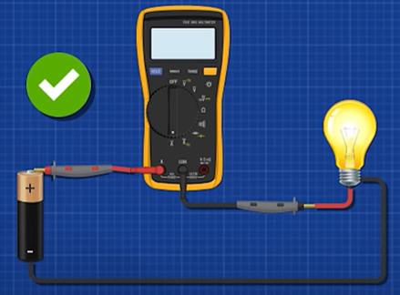
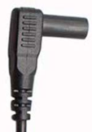
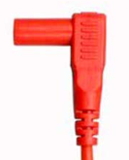
Working of Multimeter
AC
DC
Resistance measurement
Resistance, Connectivity and Diode
Capacitance
Mili Voltage
Ampere
Both DC and AC
DC Voltage
Mili Ampere
Knob
AC Voltage
Micro Ampere
To measure voltage the across the component in a circuit, you must connect the voltmeter in parallel with it
This terminal is used for measurement of ampere current
This terminal is used for measurement of voltage, resistance, diode, capacitance parameter
This terminal is used for measurement of mili and micro ampere current
This terminal is used for common
To measure the current flowing through a component in a circuit, you must connect the ammeter in series with it
Fluke 15B+ Digital Multimeter

Slide 5
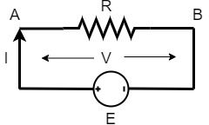
Ohm’s Law
Ohm’s law states the relationship between electric current and potential difference.
Georg Simon Ohm, a German physicist was the first to verify Ohm’s law experimentally.
Ohm’s law states that the voltage across a conductor is directly proportional to the current flowing through it, provided all physical conditions and temperatures remain constant.
Mathematically, Ohm’s law can be expressed as
V ∝ I
V = I x R
, V = Voltage applied between two points of a conducting wire, I = Current flowing through it and R = Resistance of the wire.

Slide 6
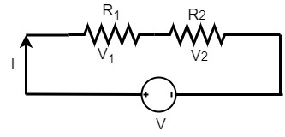
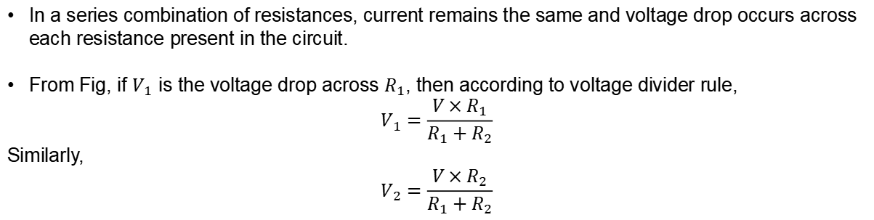
Voltage Divider Circuit
In a series combination of resistances, current remains the same and voltage drop occurs across each resistance present in the circuit.
From Fig, if $V_{1}$ is the voltage drop across $R_{1}$, then according to voltage divider rule,
$$V_{1}=\frac{V×R_{1}}{R_{1}+R_{2}}$$
Similarly,
$$V_{2}=\frac{V×R_{2}}{R_{1}+R_{2}}$$

Slide 7
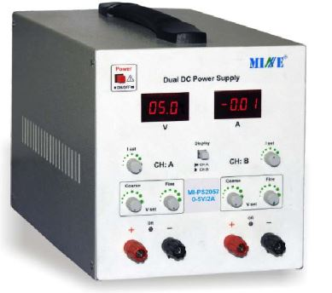
Available DC source
DC sources refer to sources of electrical energy which are associated with constant voltages and currents.
Technical Specifications:
DC Output (2nos.): 0-5V
Current max. : 2 Amp
Setting Resolution
Voltage : 10mV
Current : 10mA
Accuracy : ±1%
Input Line Voltage : 230V AC, 50Hz
Voltage Display
Current Display
Current knob
Channel selection
Voltage knob for fine tuning
Ground terminal
Voltage terminal
Channel A
Channel B

Slide 8
Voltage validation
Channel A
Channel B

Slide 9
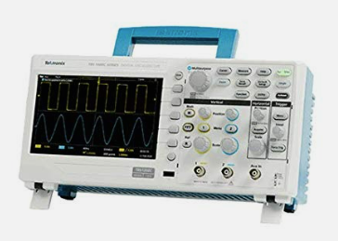
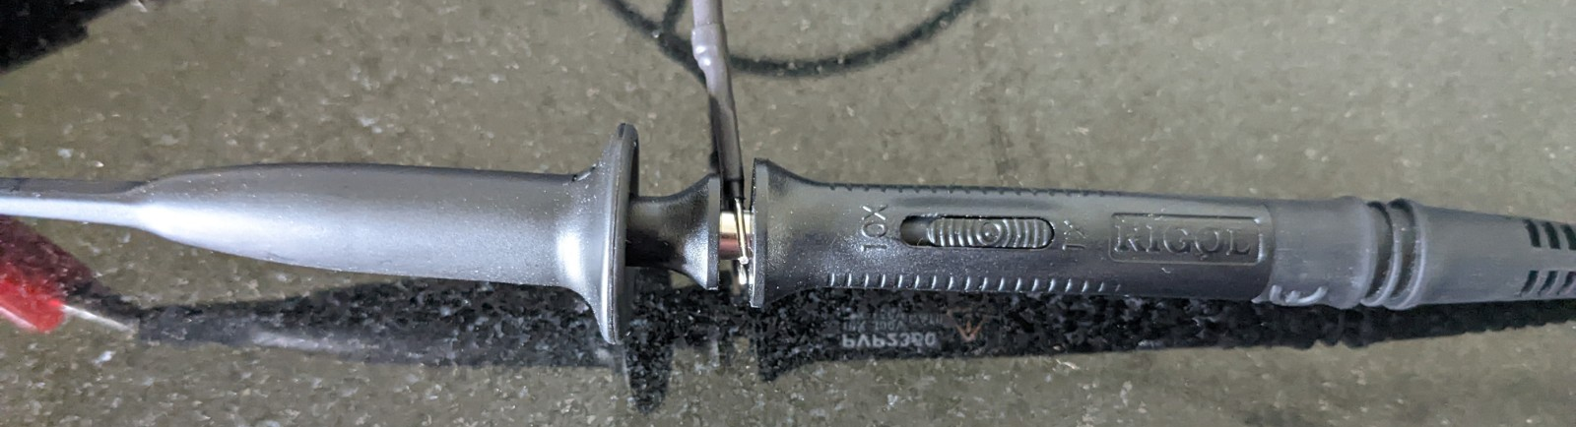
Oscilloscopes
Oscilloscopes are electronic test instruments used to visualize and analyze voltage signals.
When measuring signals with an oscilloscope, it is crucial to use an appropriate probe to match the characteristics of the signal being measured.
Attenuation modes in oscilloscope-
Attenuation is the process of reducing the amplitude of a signal.
Oscilloscope probes typically come with selectable attenuation settings to allow measurements of different voltage levels.
The two most common probe attenuation settings are 1x and 10x.

Slide 10
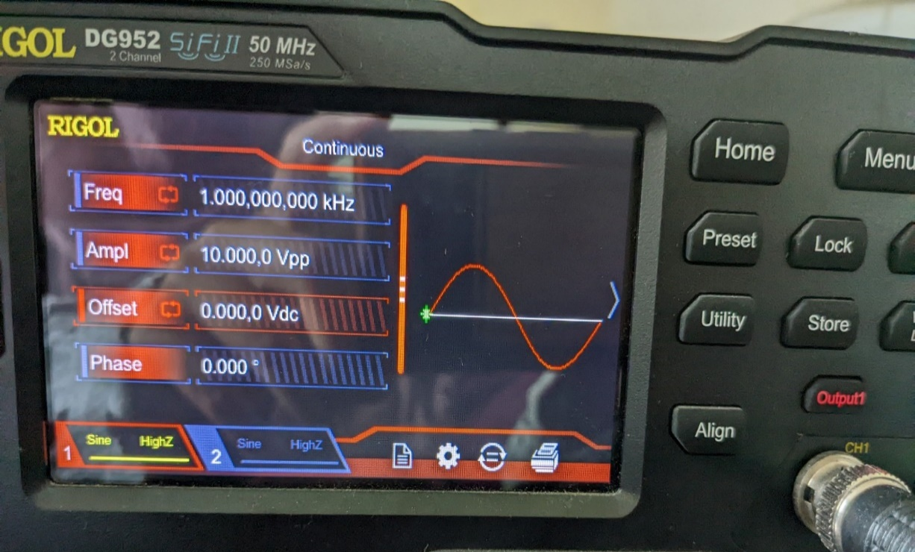
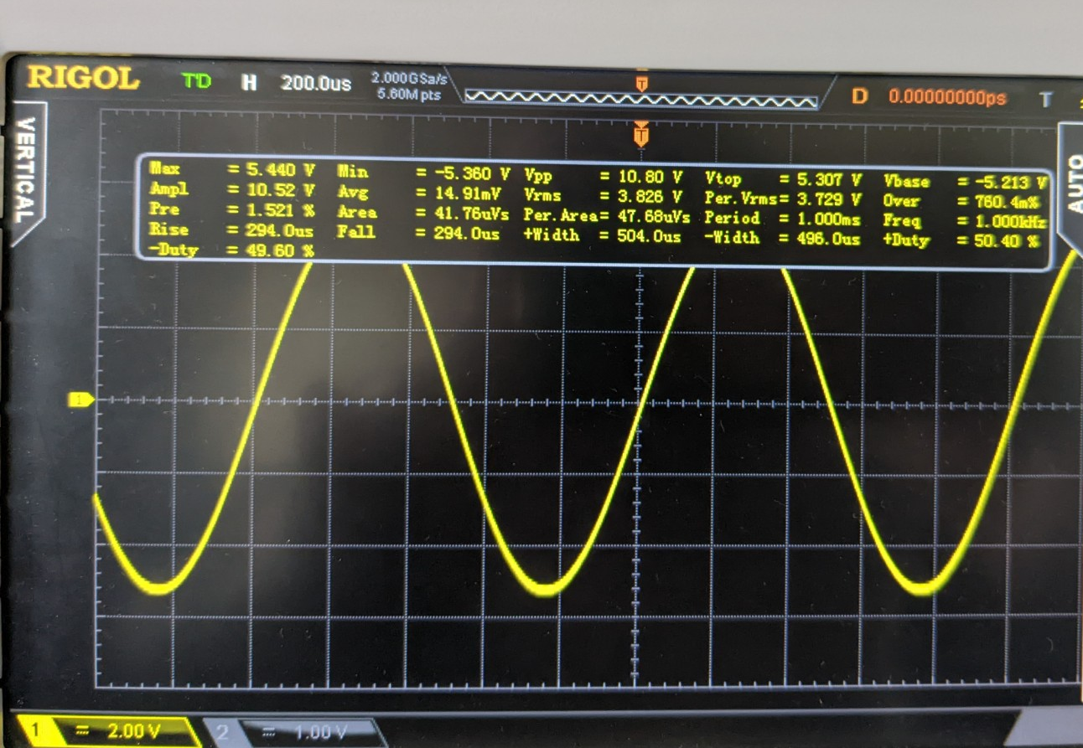
1x attenuation
If you select 1x attenuation on the oscilloscope probe, the signal will be measured at its original amplitude without any attenuation
This setting is suitable for measuring low-frequency signals or signals that have a voltage range that can be comfortably handled by the oscilloscope i.e. for lower voltage signals

Slide 11
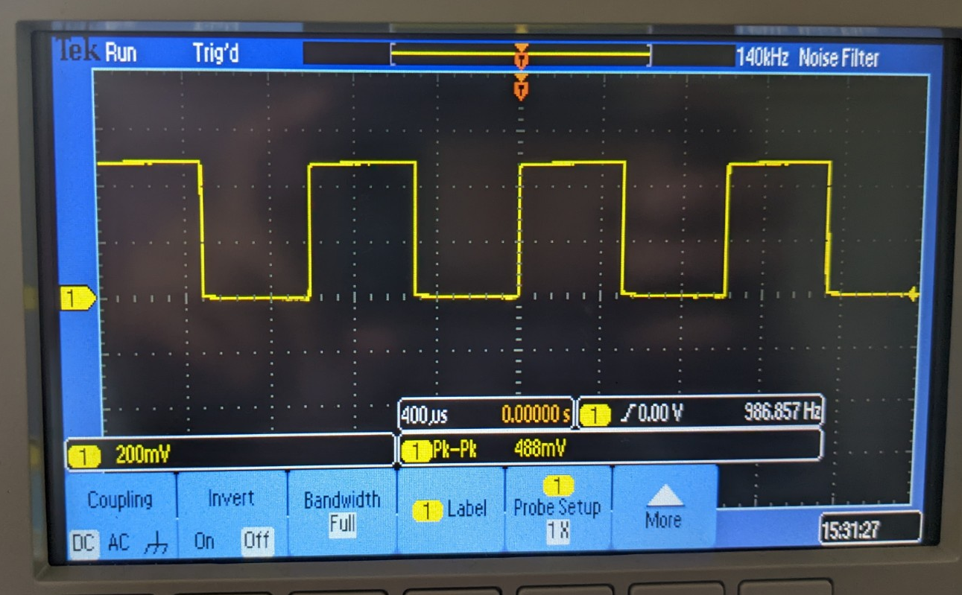
Coupling modes in oscilloscope
1. DC coupling-
DC coupling in a digital oscilloscope refers to a setting that allows the oscilloscope to display both AC (alternating current) and DC (direct current) components of an input signal.
In DC coupling mode, the oscilloscope displays the actual voltage level of the input signal at any given point in time, including any DC offset (a constant voltage offset) and any AC variations.
DC coupling can be affected by any DC offset present in the signal, which could result in the waveform being shifted up or down on the oscilloscope display.

Slide 12
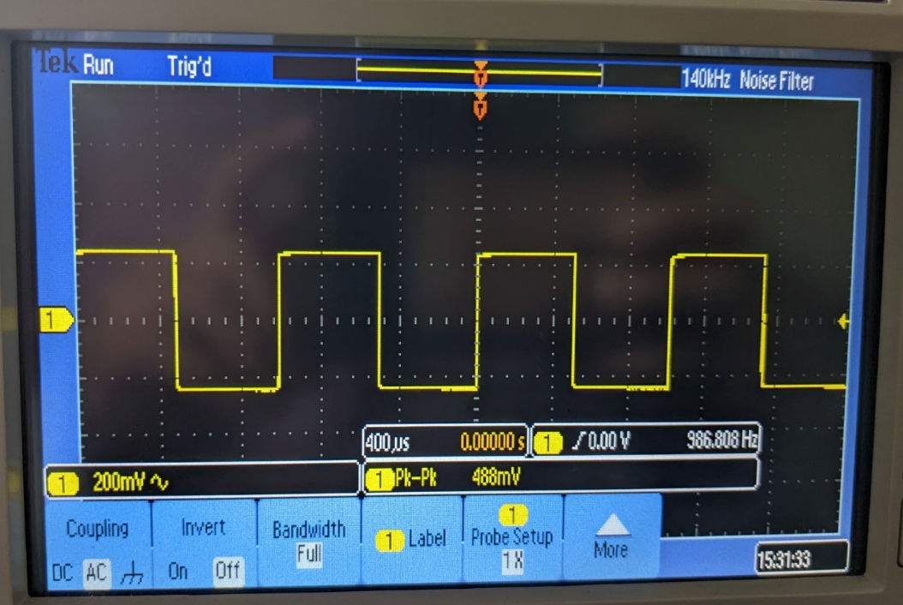
Continue
2. AC coupling-
AC coupling, also known as capacitively coupled or capacitor-coupled coupling, is a setting or mode found in oscilloscopes and other electronic devices. It is used to measure and display only the alternating current (AC) component of a signal while blocking the direct current (DC) component.
When the oscilloscope is set to AC coupling, a capacitor is inserted in series with the input signal. The capacitor blocks the DC component of the signal since it cannot pass through the capacitor due to its high impedance at low frequencies.
The oscilloscope display shows only the AC-coupled component of the signal, effectively removing any DC offset and displaying only the variations around the zero voltage level.
Can be used when we want to test ripples in the capacitor.

Slide 13
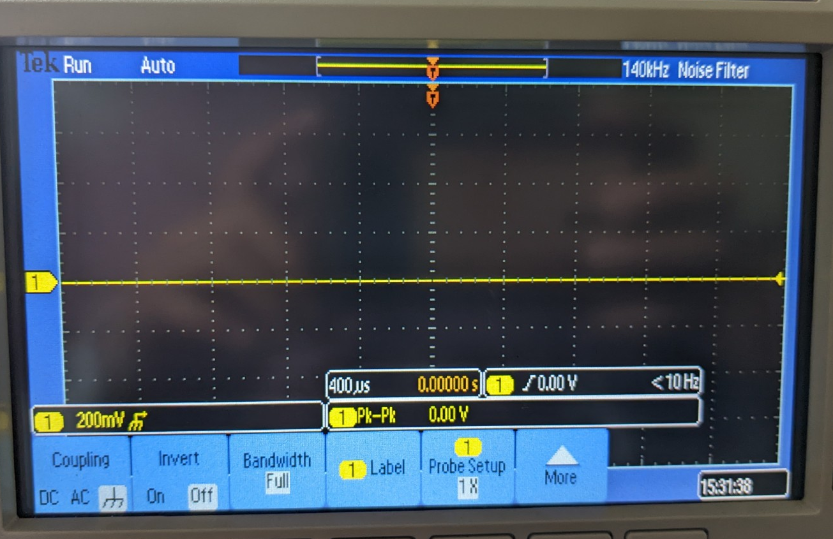
Continue
3. Ground coupling-
In case of ground coupling the oscilloscope will not show any thing.

Slide 14
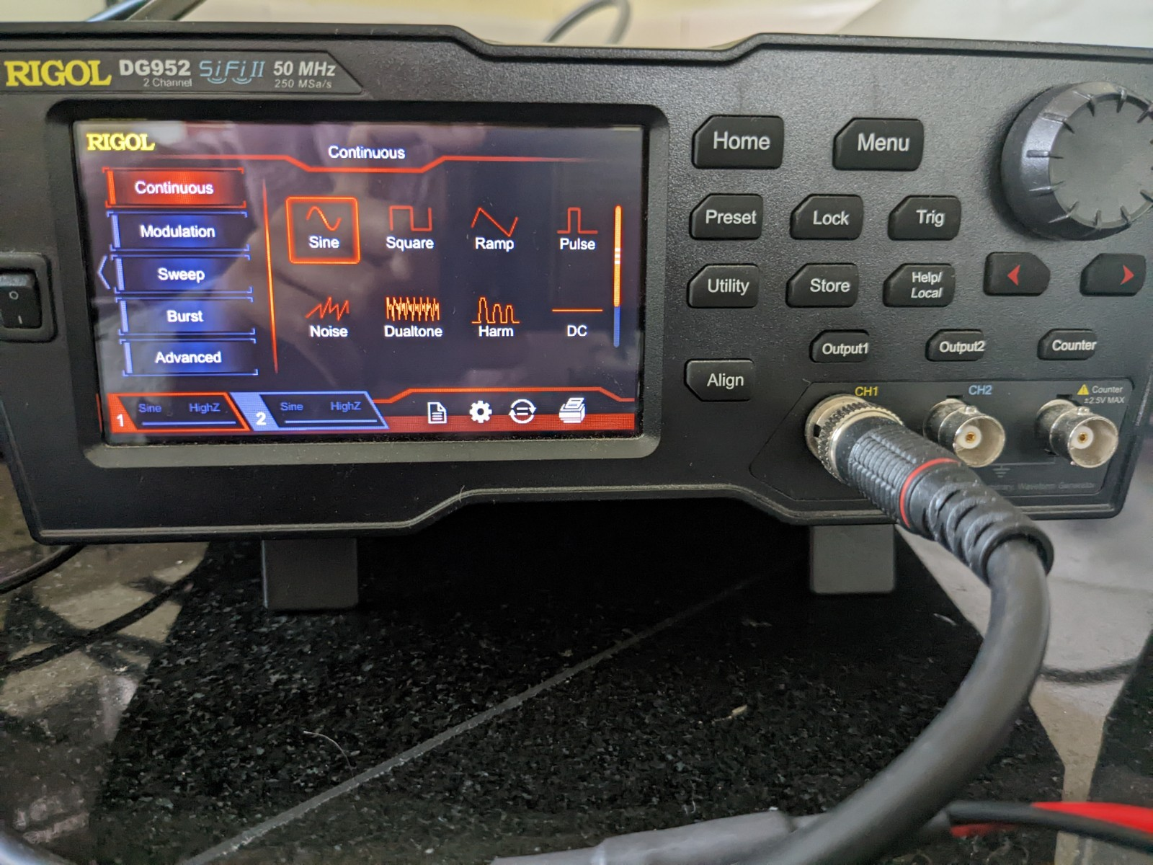
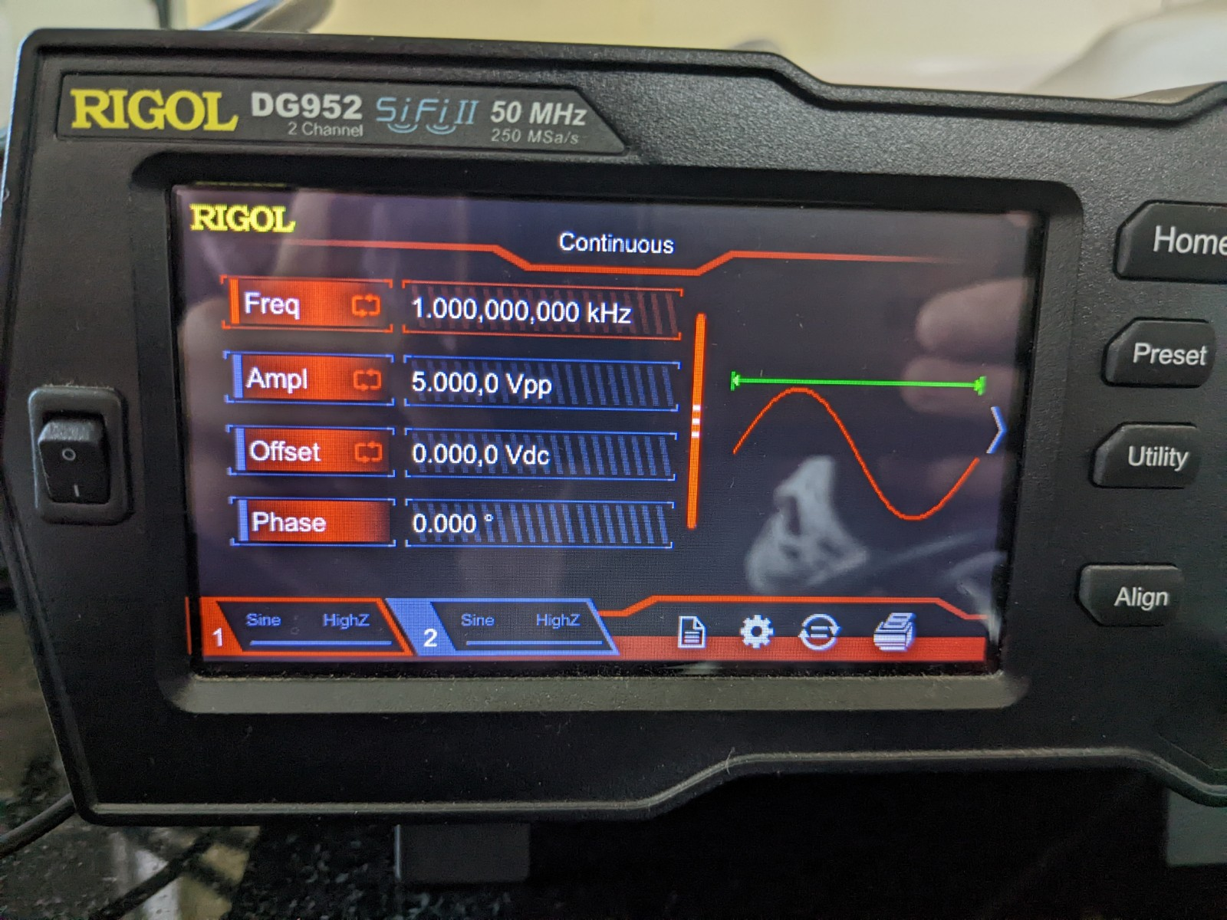
Function Generator
How to generate input signal from function generator-
Click on menu.
Select type of wave form and waveform parameters.

Slide 15
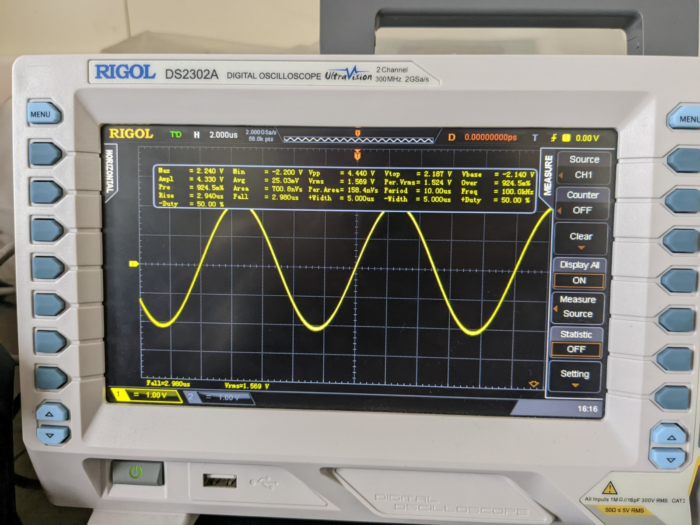
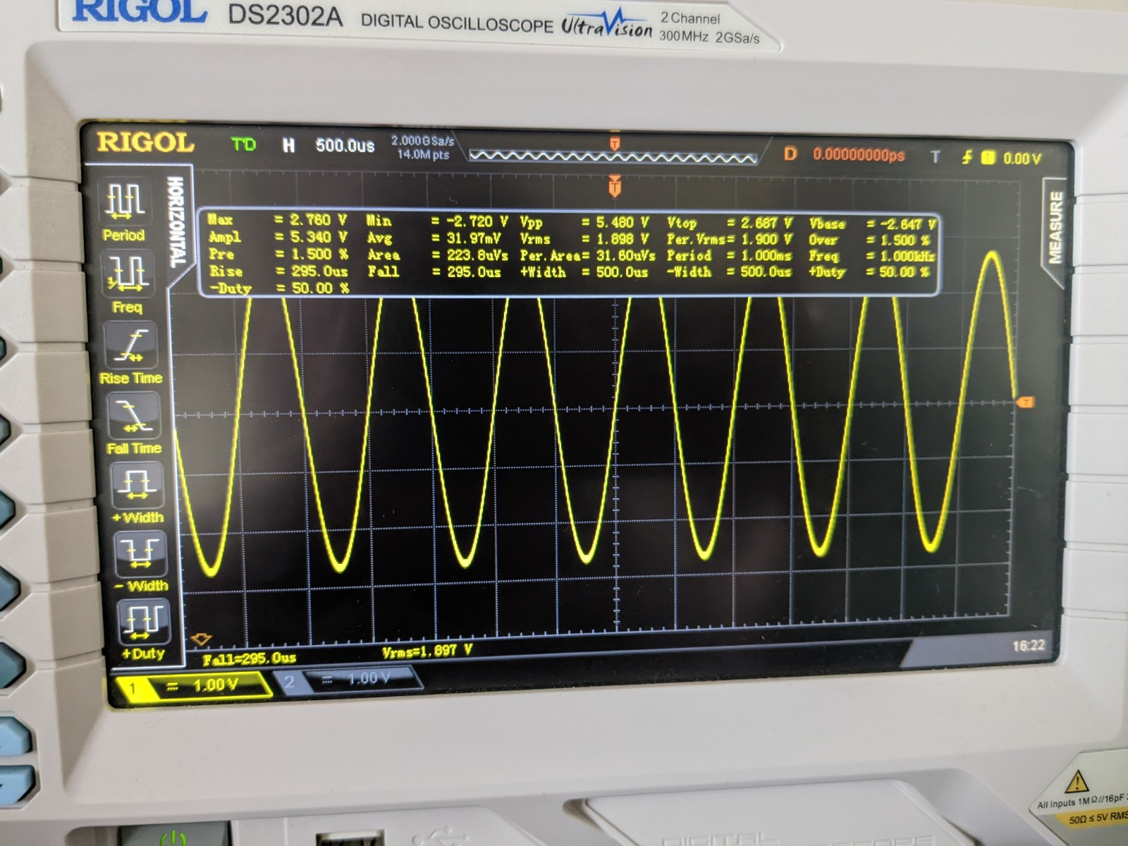
Continue
Output is displayed on oscilloscope.

